Slide 1
Sprint Presentation
By: Mia Lizzo, Ransom Miller, IV, Vincent Negri

Slide 2
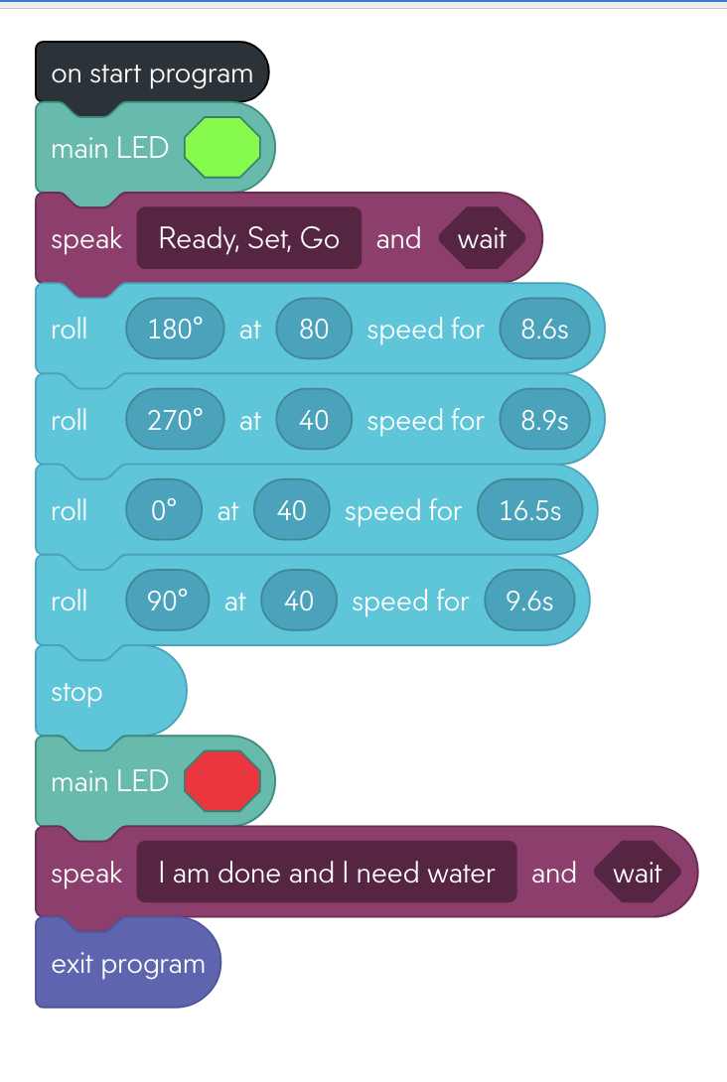
Sprint 1 - Endurance

Slide 3
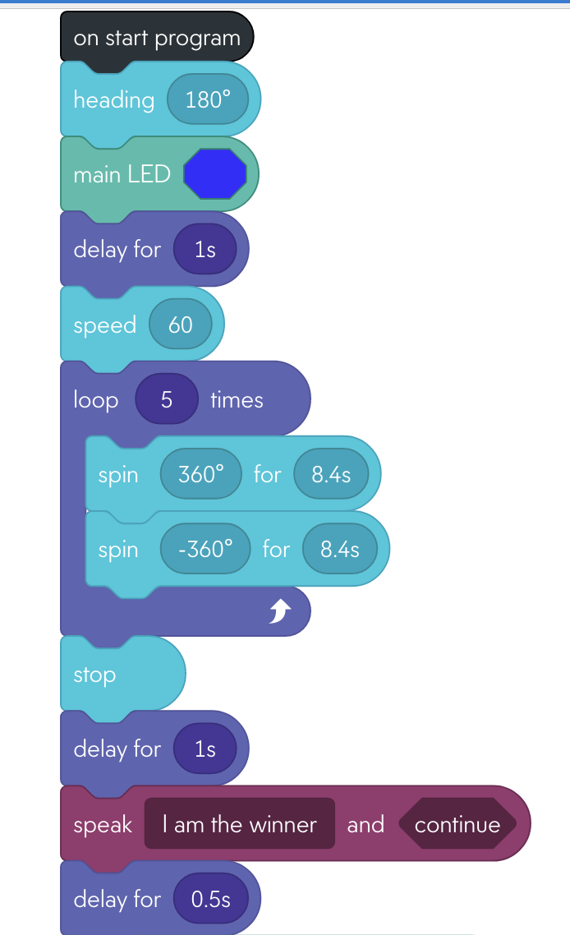
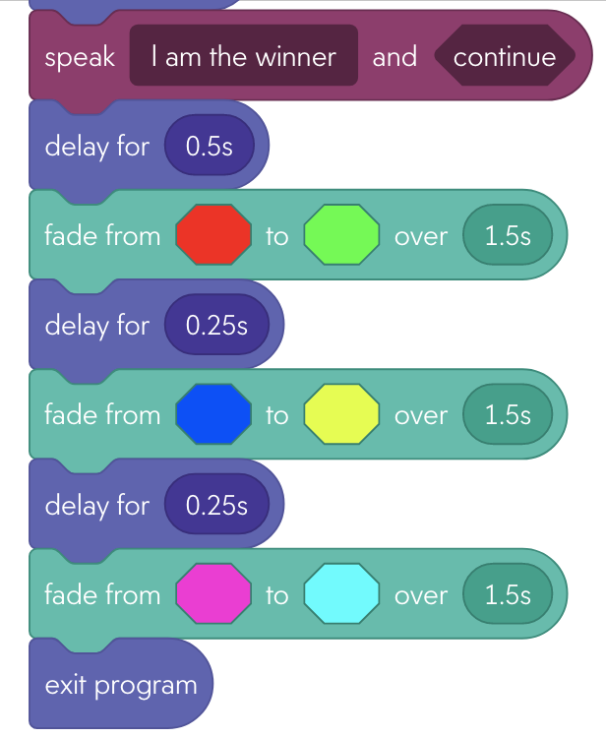
Sprint 2 - Accuracy

Slide 4
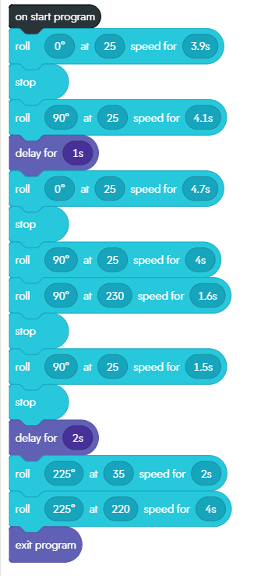
Sprint 3 - Agility

Slide 5
Video of All Sprints

Slide 6
Challenges we faced
Hardware Issues
Occasional Issues with coding
Robot Issues
Trial and Error
Completing the Objectives
Different Schedules

Slide 7
Roles of each team member
Mia Lizzo – Writer
To document the project and write the necessary definitions. Since she lives in Florida this is the only way possible.
Vincent Negri – Leader
To organize, plan and execute this project. Keep the necessary items on track to be completed. Stay on top of team members and himself.
Ransom Miller, IV – Coder
To keep the robot and write the necessary code within the Sphero program.

Slide 8
What have you learned about software engineering?
The intricacies of designing software
You have to be detailed in your code
You have to be concise, one mistake can ruin the code
It's not a one and done scenario, we have to test many times
You won’t discover a breakthrough overnight

Slide 9
What would you do differently?
Better communication
To have knocked down all the pins in Sprint 3
Write the code before day of testing
Make sure the hardware is ready for use
Have a plan as to when to complete everything

